Slide 1

Offline Multilingual ASR for Indic Languages Using OpenAI’s Whisper
Presented by: Kadwasra Swapna, Maha Lakshmi, Sheri Shiva Prasad Reddy
Guided by: Dr. Bittu Kumar
Affiliation : Department of Electronics and Communication Engineering Koneru Lakshmaiah Education Foundation, Hyderabad, India

Slide 2
Introduction
Offline ASR enhances privacy & accessibility.
Indic languages pose unique linguistic challenges.
Whisper enables multilingual speech-to-text conversion.
Optimized for low-resource settings & offline use.
Goal: Develop an offline, web-based ASR and translation system for Indic languages.
Kadwasra Swapna, Maha Lakshmi, Sheri Shiva Prasad Reddy

Slide 3
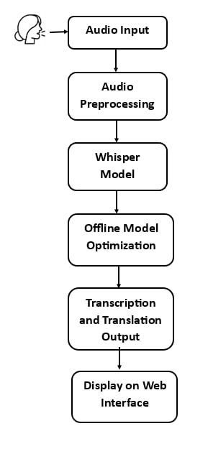
Proposed Methodology
Model Selection: Use OpenAI’s Whisper for ASR.
Language Handling: Optimize for Indic language recognition.
Offline Deployment: Implement without internet dependency.
User Interface: Develop a simple, accessible application.
Performance Testing: Ensure accuracy & efficiency
Kadwasra Swapna, Maha Lakshmi, Sheri Shiva Prasad Reddy

Slide 4
System Architecture
Input Module: Accepts speech input from users
Preprocessing Unit: Enhances audio quality & normalizes input.
ASR Engine (Whisper): Converts speech to text offline.
Post-Processing: Enhances accuracy and formats text output.
Offline Execution: Runs locally without internet dependency.
Output Module: Displays or saves transcribed text.
Kadwasra Swapna, Maha Lakshmi, Sheri Shiva Prasad Reddy

Slide 5
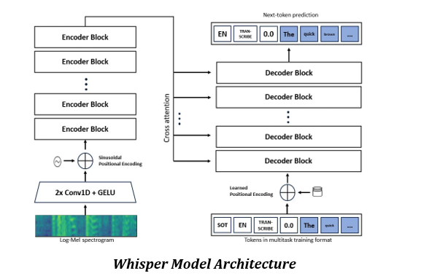
Kadwasra Swapna, Maha Lakshmi, Sheri Shiva Prasad Reddy

Slide 6
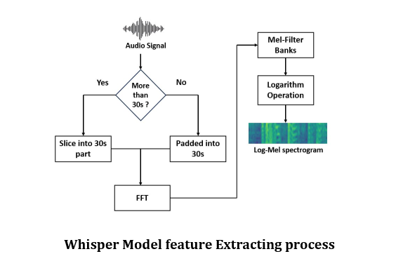
Kadwasra Swapna, Maha Lakshmi, Sheri Shiva Prasad Reddy

Slide 7
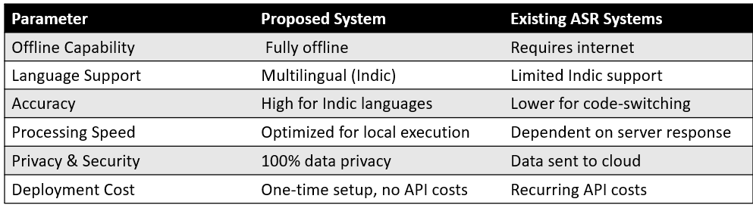
Results
Successfully converted speech to text across multiple languages.
Achieved low latency and high accuracy in offline mode.
Demonstrated robust performance in real-world scenarios.
Kadwasra Swapna, Maha Lakshmi, Sheri Shiva Prasad Reddy

Slide 8
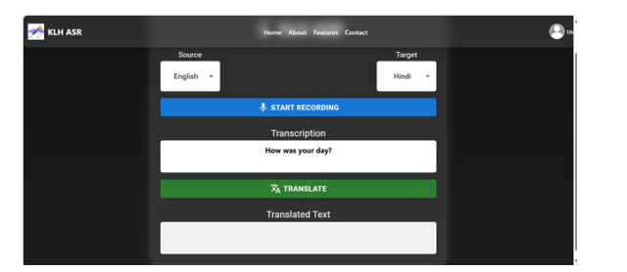
Kadwasra Swapna, Maha Lakshmi, Sheri Shiva Prasad Reddy

Slide 9
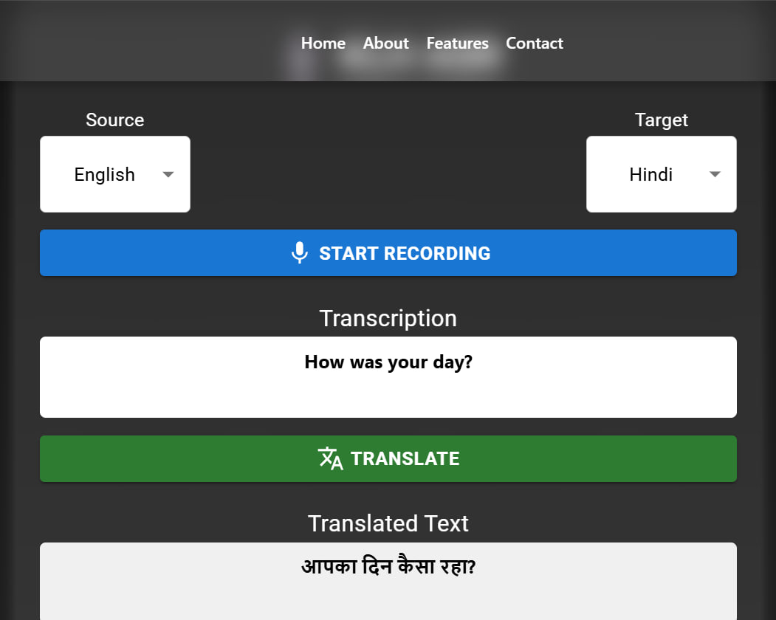
Kadwasra Swapna, Maha Lakshmi, Sheri Shiva Prasad Reddy

Slide 10
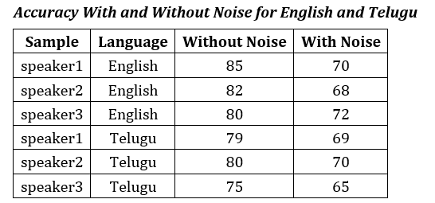
Kadwasra Swapna, Maha Lakshmi, Sheri Shiva Prasad Reddy

Slide 11
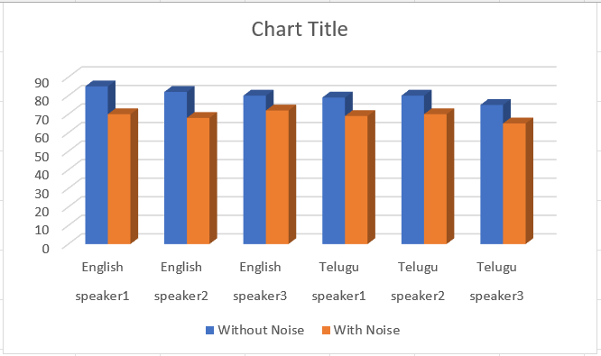
Kadwasra Swapna, Maha Lakshmi, Sheri Shiva Prasad Reddy

Slide 12
Conclusion
Successfully developed an offline ASR system optimized for Indic languages.
Ensured privacy and security by eliminating cloud dependency.
Achieved high accuracy and low latency for speech-to-text conversion.
Provided a cost-effective solution with no recurring API costs.
Kadwasra Swapna, Maha Lakshmi, Sheri Shiva Prasad Reddy

Slide 13
Future Work
Improve Dialect Recognition: Enhance model adaptability to regional variations.
Optimize Performance: Reduce processing time for real-time applications.
Expand Language Support: Incorporate more Indic and low-resource languages.
Develop User-Friendly UI: Enhance accessibility for diverse users.
Kadwasra Swapna, Maha Lakshmi, Sheri Shiva Prasad Reddy

Slide 14
Thank You!
Kadwasra Swapna, Maha Lakshmi, Sheri Shiva Prasad Reddy

